Slide 1
About:
The project is about taking survey from users, before and after their training.
Project uses Bootstrap, jQuery, Angular, FontAwesome, Firebase Authentication, Firebase Deployment.
Currently I have enabled the users to update their feedback too, but It can be restricted.
Setup up the environment:
Install Git Bash, Angular-Cli and NodeJs.
    https://git-scm.com/downloads
    https://cli.angular.io/
    https://nodejs.org/en/
Clone git repository and install required packages:
    git clone https://github.com/phoenixnitin/survey-shrike-ui.git
    cd survey-shrike-ui
    npm install
To run:
    npm run start
    Now access http://localhost:4200

Slide 2
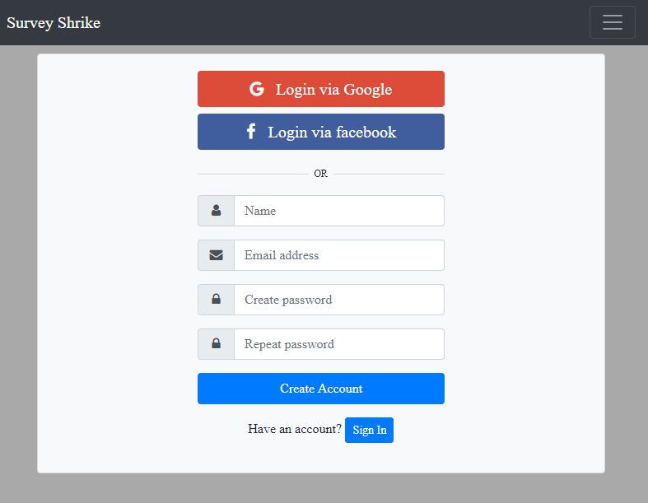
Home Page:

Slide 3
Available paths after Logging in:
https://localhost:4200/#/home
https://localhost:4200/#/pre-training
https://localhost:4200/#/post-training
Note: Pre Training and Post Training path will only be available if you are logged in. All the other paths will redirect you to home(login page).
Endpoints to fetch data:
Type: Post
  <Base URL>/pretraining/create
  <Base URL>/posttraining/create
  <Base URL>/pretraining/findByEmail
  <Base URL>/posttraining/findByEmail
Type: Put
  <Base URL>/pretraining/update/{id}
  <Base URL>/posttraining/update/{id}
Note: Here <Base URL> corresponds to backend server running at http://localhost:8080

Slide 4
Firebase Deployment:
For Firebase deployment, you need to install npm package firebase-tools and create a project in firebase console. Then from cmd give these commands and follow the steps. For public directory I have given the build path.
  firebase login (then go to given link to continue authentication)
  firebase init
    Select your project and set the path when asked
  firebase deploy
After this you will get the deployed URL.

